Slide 1
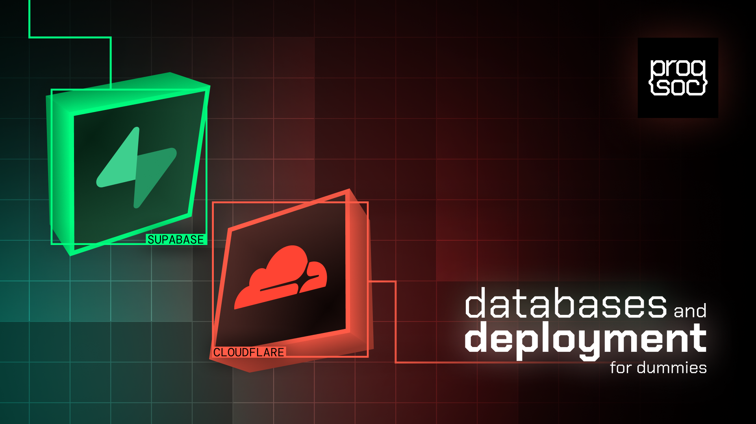

Slide 2
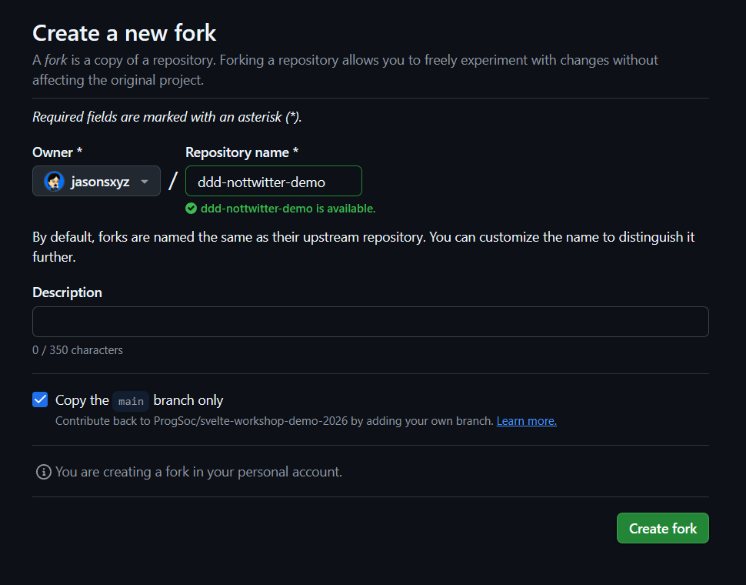
Before we begin
Fork the scaffold for this workshop
https://github.com/ProgSoc/ddd-workshop-scaffold
Make sure you have the latest version of NodeJS installed
v22.17 or higher

Slide 3
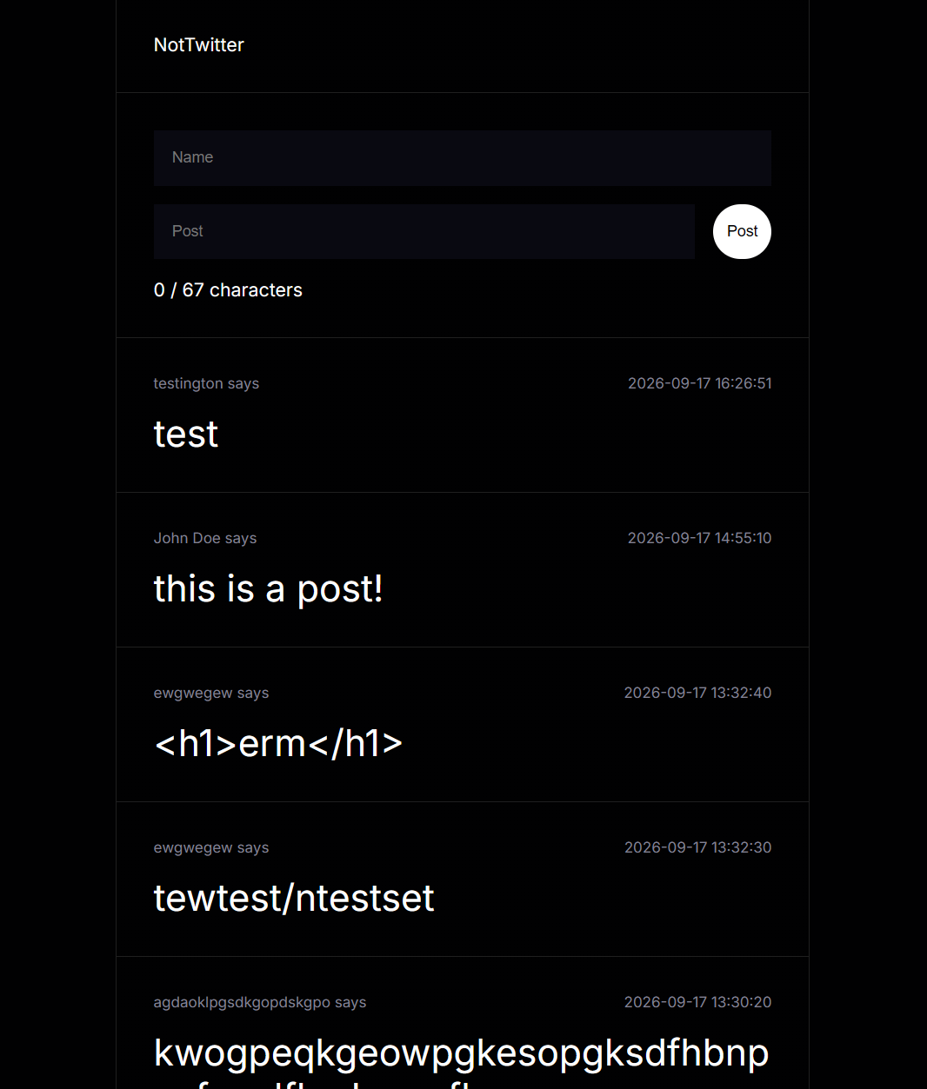
Today
We’ll be making everyone’s favorite social media (...again)
  NotTwitter

Slide 4
How this Workshop will work
Part 1: Supabase
  We’ll be going through the basics of Supabase, and implementing it into the scaffold project!
Part 2: Cloudflare
  We’ll be deploying the finished project onto the web!
Exploring the Supabase Dashboard
Implementing Supabase in SvelteKit (supabasejs)
  Reading Rows (SELECT)
  Posting to Table Rows (INSERT)
Setting up Wrangler
Linking your GitHub repository to Cloudflare
Handling Environment Variables
Both parts don’t depend on each other. If you get lost in Part 1 once we reach to Part 2, you can still learn the basics of deploying your project with Cloudflare

Slide 5
Part 1
Supabase

Slide 6
What is Supabase?
Supabase is an open source Backend as a Service platform built on PostgreSQL.
It automatically generates API endpoints based on your database’s schema
Has other features which can come in handy with scaling your project’s backend
Auth, Storage, Realtime, Edge Functions, etc.

Slide 7
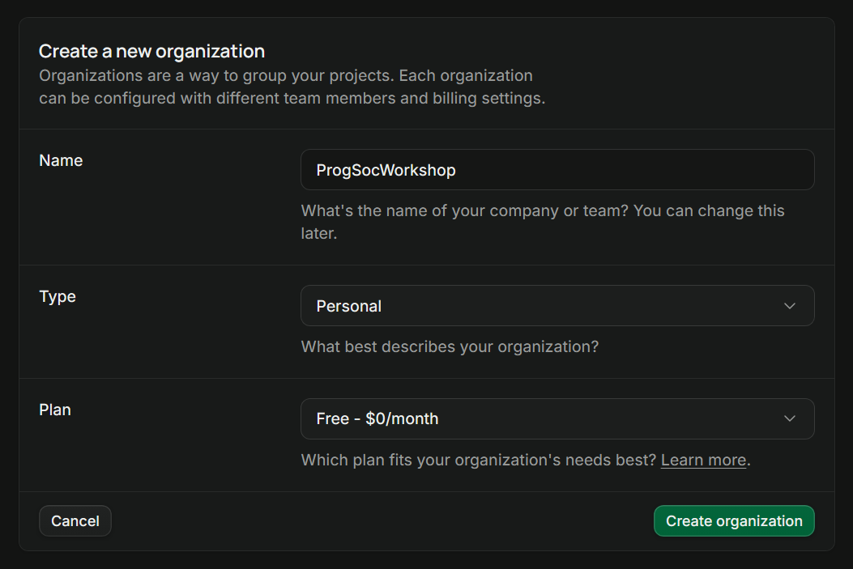
Create an Organization

Slide 8
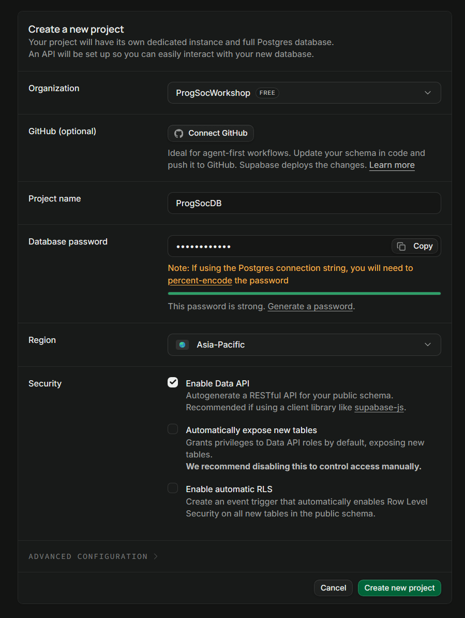
Create a Project
Use the organization you just created
Give it a name and password
Make sure Enable Data API is enabled
Disable automatically expose new tables

Slide 9
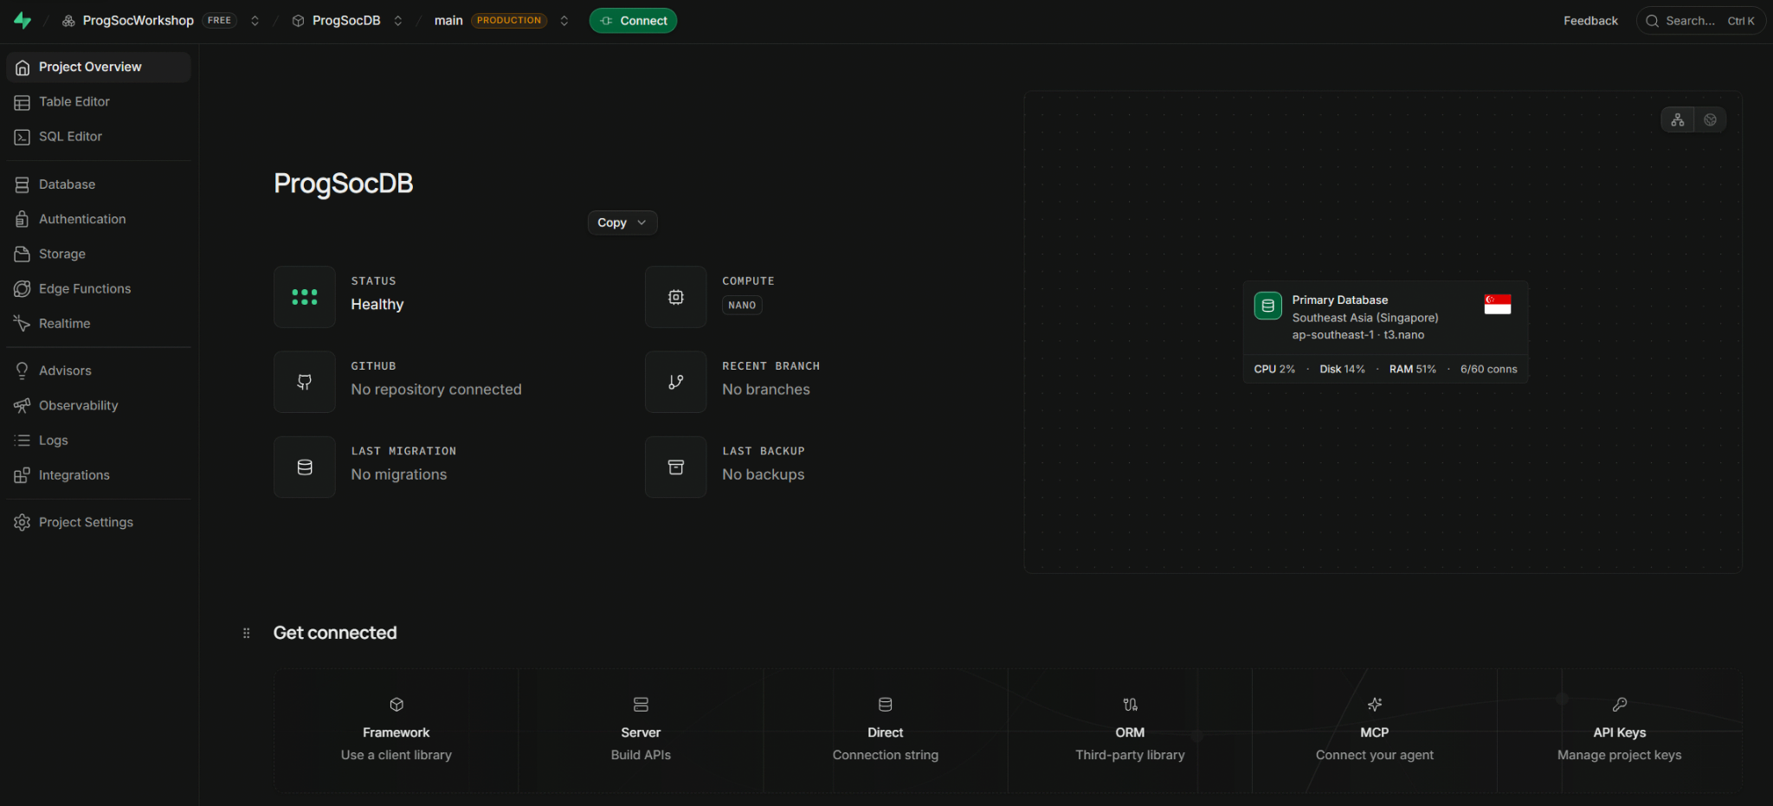
Dashboard
Our focus will be on
  Table Editor
  Database

Slide 10
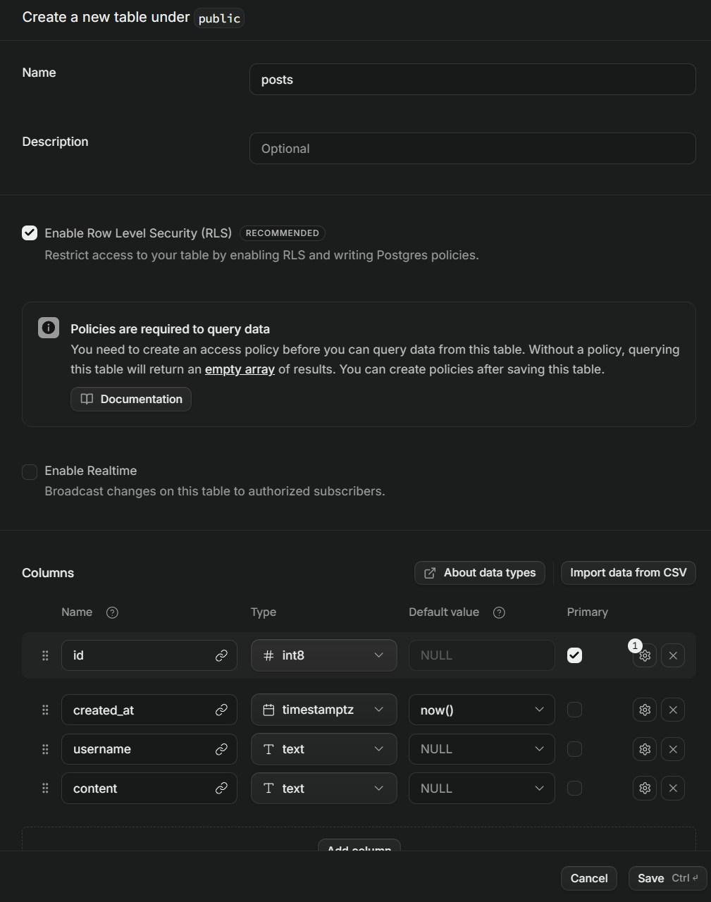
Tables
For this workshop, we’ll just be playing around with this singular table for NotTwitter.
Name it “posts”
Make it have a created_at, username, and content column.
Username and content are NOT Nullable.

Slide 11
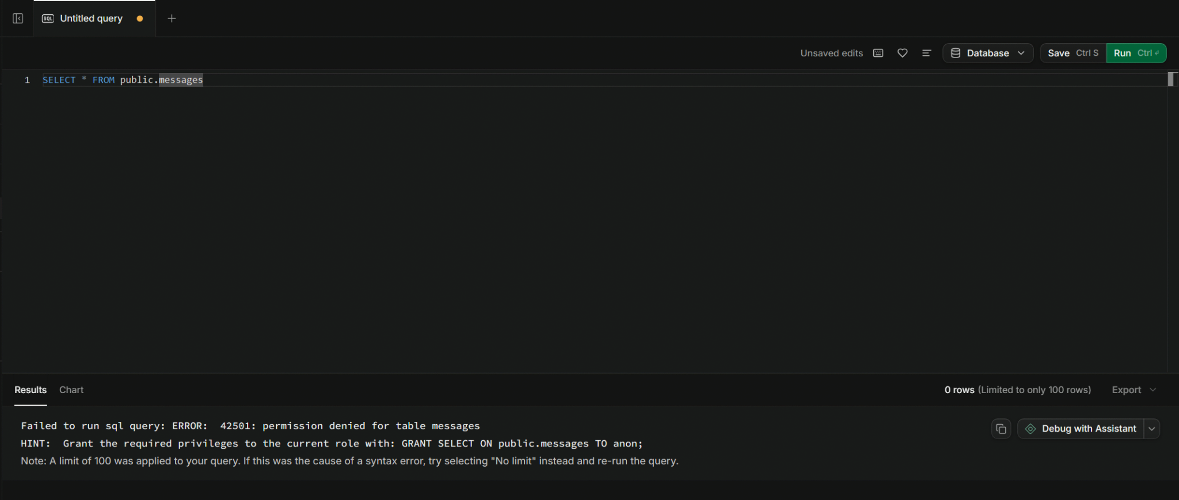
Row Level Security (RLS)
Row Level Security is a feature inside of PostgreSQL which checks if the user has the right permissions to CREATE, READ, UPDATE, or DELETE tables.

Slide 12
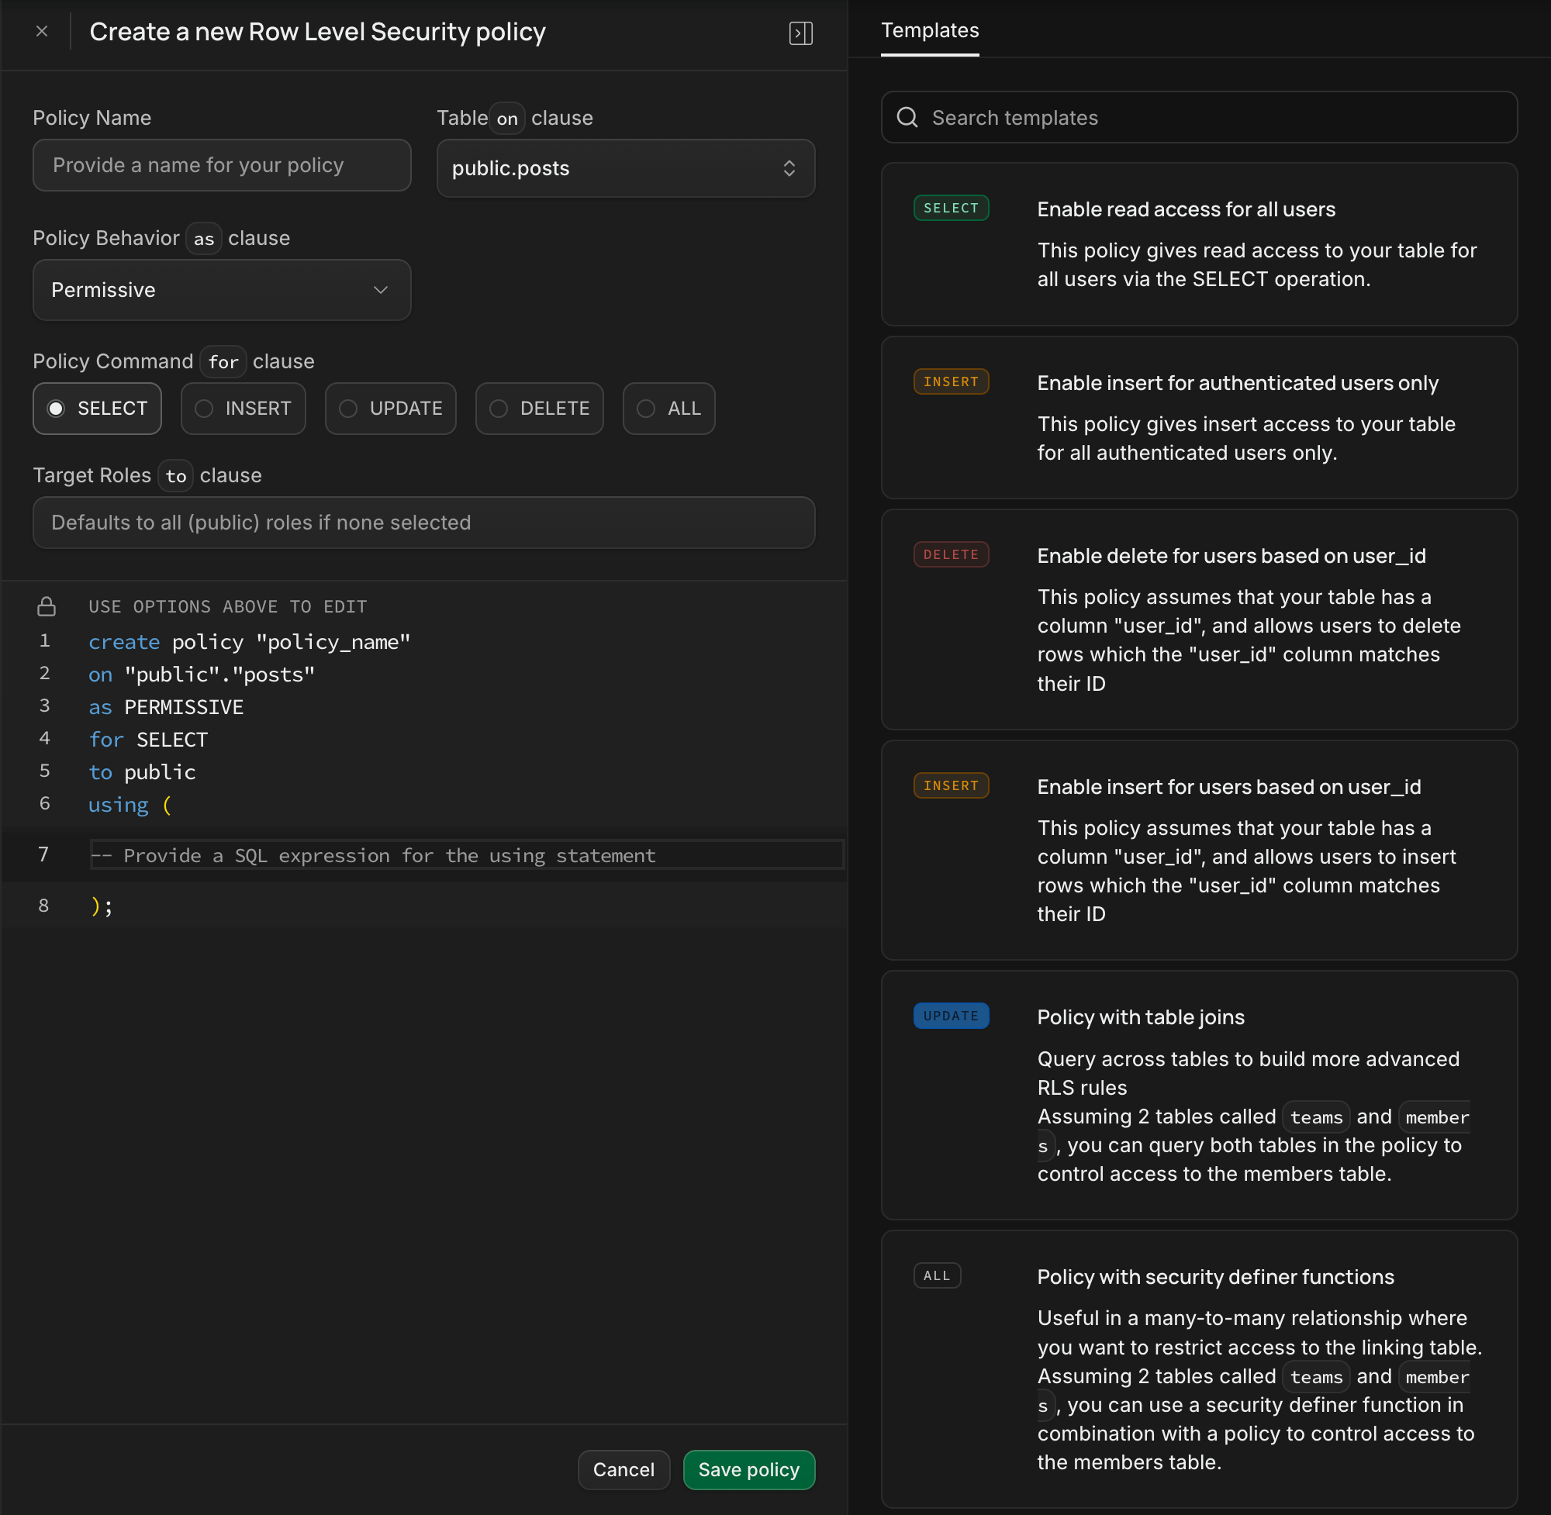
Row Level Security (RLS)
You’ll need to create two Row Level Security policies in order to read and insert into the rows.
Enable Read Access for All Users
Enable Insert for All Users

Slide 13
Project Scaffold
This workshop’s scaffold is built on SvelteKit.
Supabase provides easy to understand documentation on how to connect Supabase to whatever framework you use for your project.
For SvelteKit, it provides the following:
.env
src/lib/supabaseClient.ts

Slide 14

Implementation (.env)
.env files are used to store Environment Variables.
Environment Variables are values that can be configured outside of your code, such as API keys, database URLs, and configuration settings.
Keep sensitive values out of your source code, and make sure .env is included in your .gitignore so it isn’t accidentally committed to Git.

Slide 15
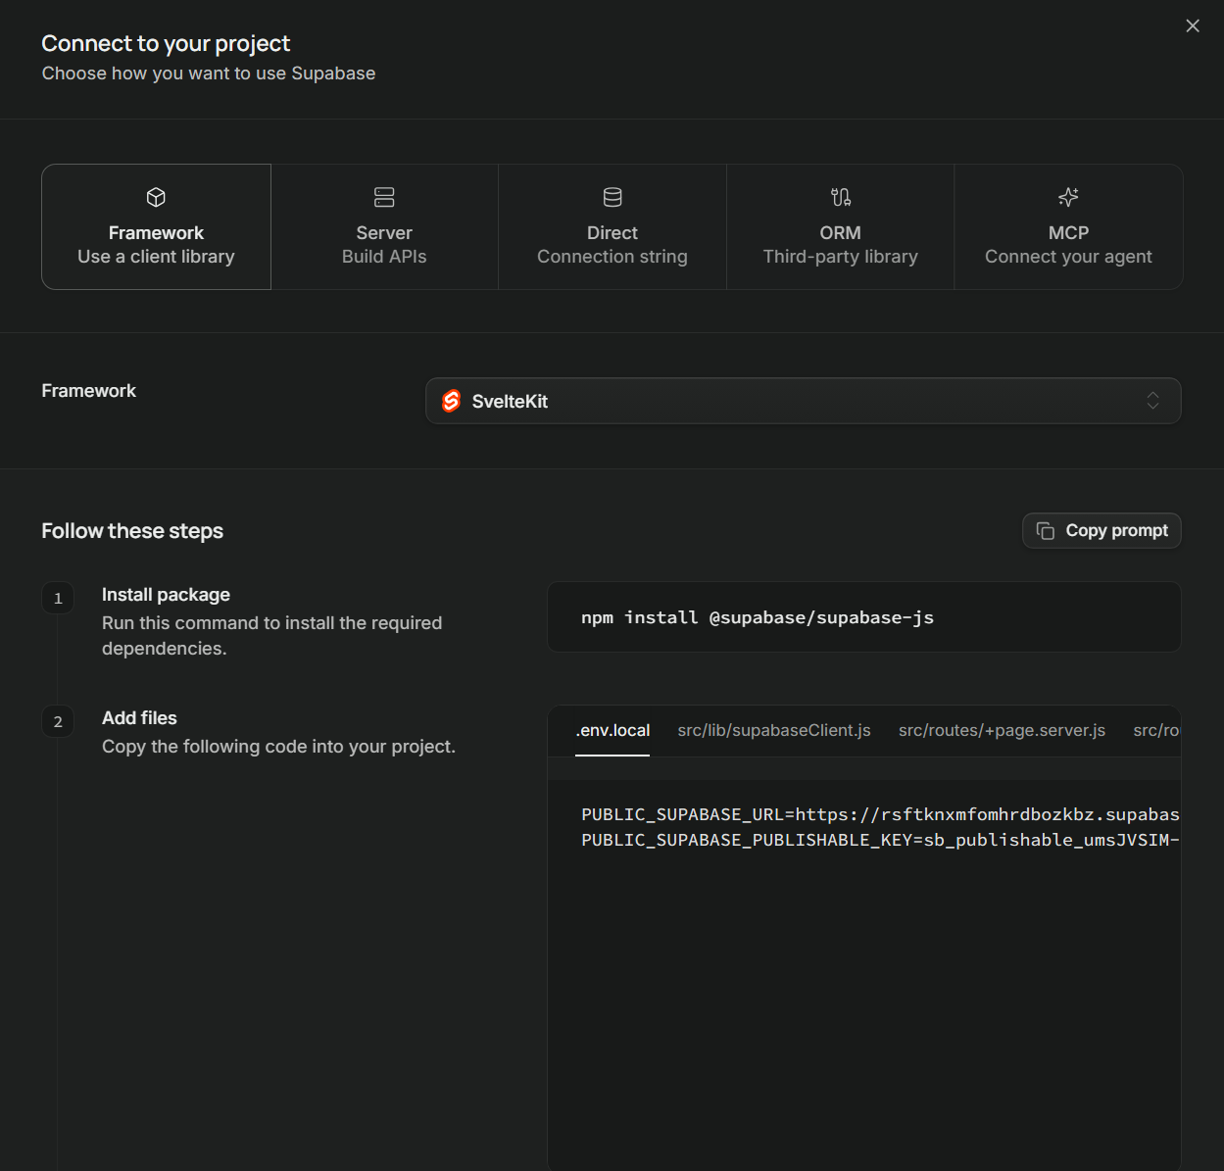
Implementation (.env)
You can find the required environment variables for Supabase by heading to Project Overview and clicking on “Framework (Use a client library)” underneath the Get Connected section.

Slide 16
SupabaseJS
Instead of having to use the fetch function for API calls, SupabaseJS wraps everything into functions for simplicity.
Using Fetch | Using SupabaseJS
const url = 'https://supabase.co*'; const response = await fetch(url, { method: 'GET', headers: { 'apikey': 'your-anon-key', 'Authorization': 'Bearer your-anon-key' } }); const data = await response.json(); | const { data, error } = await supabase .from('table') .select('*');

Slide 17
SQL to SupabaseJS examples
Data API Documentation: https://supabase.com/dashboard/project/_/integrations/data_api/docs?page=tables-intro
SQL to Rest / SupabaseJS translator: https://supabase.com/docs/guides/api/sql-to-rest
What | In SQL | In SupabaseJS
Return rows from the table "table_name" | SELECT * FROM posts; | const { data, error } = await supabase .from('posts') .select('*');
Return rows from the table "table_name" WHERE column_name is "value" | SELECT * FROM posts WHERE username = 'Jane Doe'; | const { data, error } = await supabase .from('posts') .select('*'); .eq(‘username’, ‘Jane Doe’);
Insert a row into the table "table_name" | INSERT INTO table_name (column_1, column_2) VALUES ('value_1', 'value_2'); | const { data, error } = await supabase .from('table_name') .insert({ column_1: 'value_1', column_2: 'value_2' });
Return rows where column_name contains "search_term" (case insensitive) | SELECT * FROM table_name WHERE column_name ILIKE '%search_term%'; | const { data, error } = await supabase .from('table_name') .select('*') .ilike('column_name', '%search_term%');

Slide 18
Task 1: Get POs
/routes/+page.server.ts
SQL:
SELECT * FROM messages
SupabaseJS:
const { data, error } = await supabase
.???
.???;

Slide 19
Task 2: Post Messages
/src/lib/components/Post.svelte
SQL:
INSERT INTO messages VALUES (username, content) VALUES (‘user’, ‘hi’)
SupabaseJS:
const { data, error } = await supabase
.???
.???;

Slide 20
Task 3: Get Posts from a user
/routes/search/+page.svelte
SQL:
SELECT * FROM posts WHERE username = “”
SupabaseJS:
const { data, error } = await supabase
.???
.???
.???;

Slide 21
Task 4: Get Messages containing XYZ
/routes/search/+page.svelte
SQL:
SELECT * FROM posts WHERE content ILIKE ‘%XYZ%’
SupabaseJS:
const { data, error } = await supabase
.???
.???
.???;

Slide 22
Task 5: Get Messages from a user AND contains XYZ
/routes/search/+page.svelte
SQL:
SELECT * FROM posts WHERE username = ‘jeff’ AND content LIKE ‘%XYZ%’
SupabaseJS:
const { data, error } = await supabase
.???
.???
.???
.???;

Slide 23
FUN BREAK
I’ll give you about 5-10 minutes to do random stuff to the styling of NotTwitter so it’s unique to you

Slide 24
Part 2
Cloudflare Workers

Slide 25
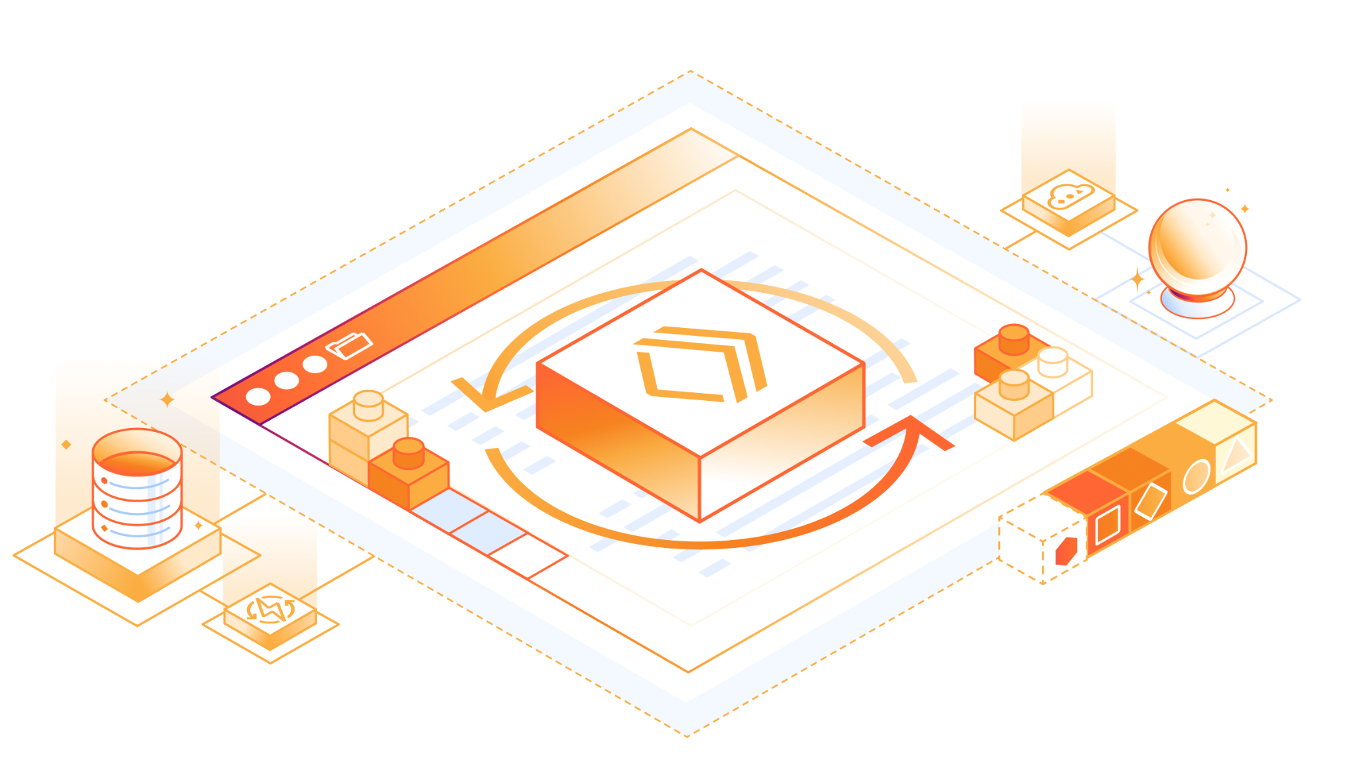
What is Cloudflare Workers?
Workers is a platform that Cloudflare provides which lets you deploy your apps across their network.

Slide 26
Wrangler Setup
Setup Wrangler
  npx wrangler setup
Generate your project’s types
  npx wrangler types
Publish your project to GitHub!

Slide 27
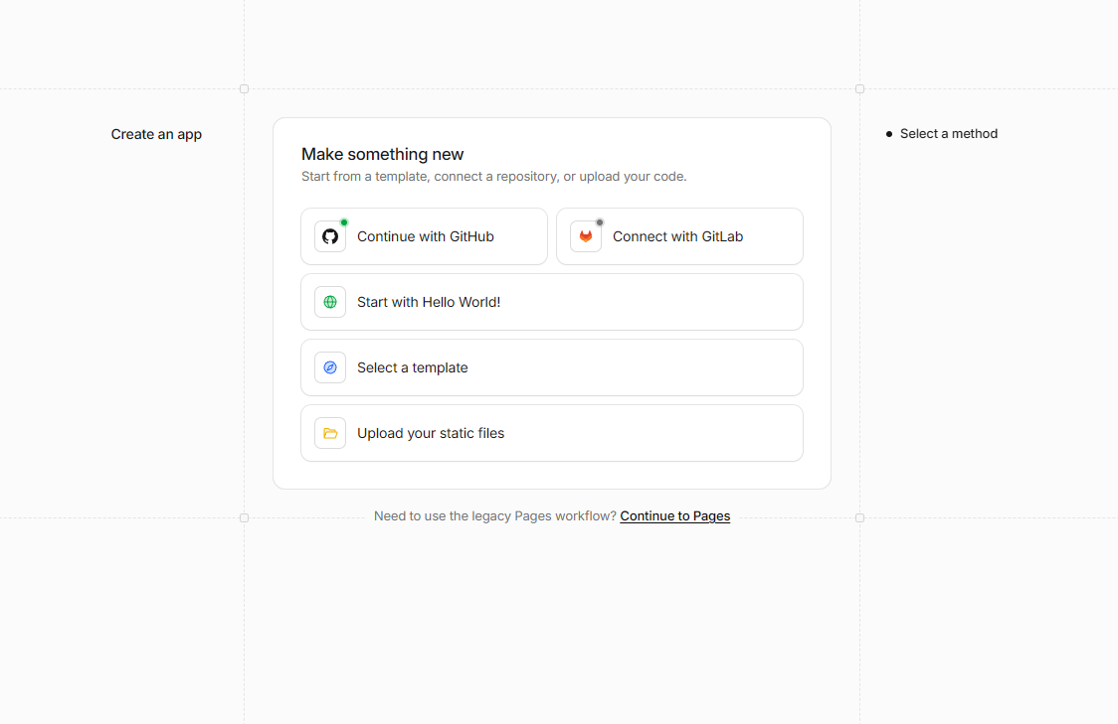
Connect Repo to Worker
Make sure you’ve published your repo and linked your GitHub account to Cloudflare.
Every commit you do to the main inside of your repo will automatically build on Wrangler.

Slide 28
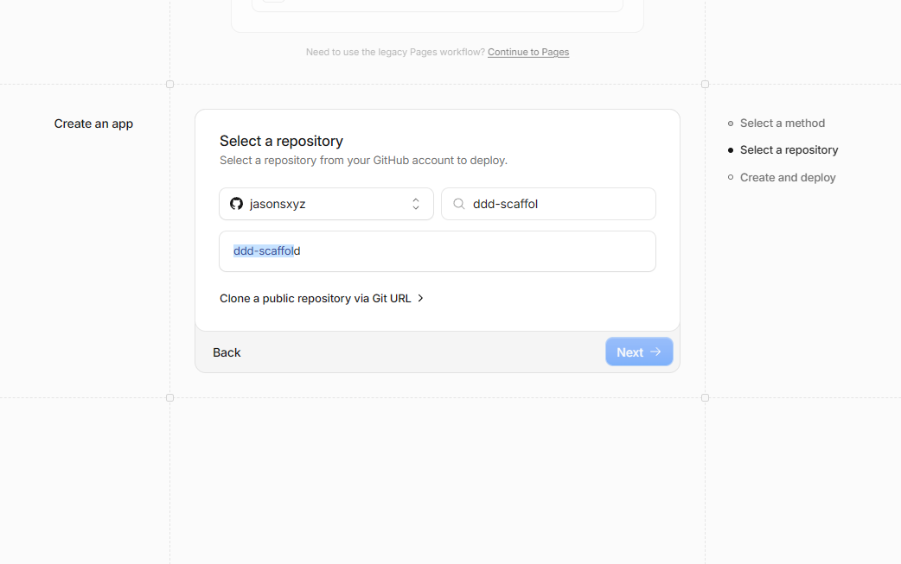
Connect Repo to Worker
Select the ddd-scaffold-workshop repository in your account.

Slide 29
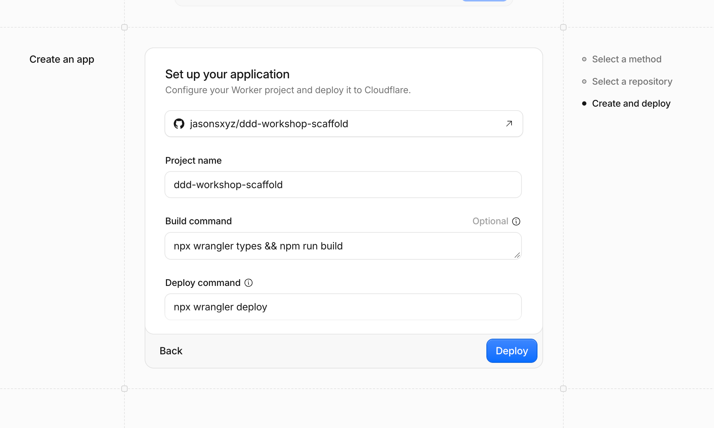
Connect Repo to Worker
Make sure your build and deploy commands look the same

Slide 30
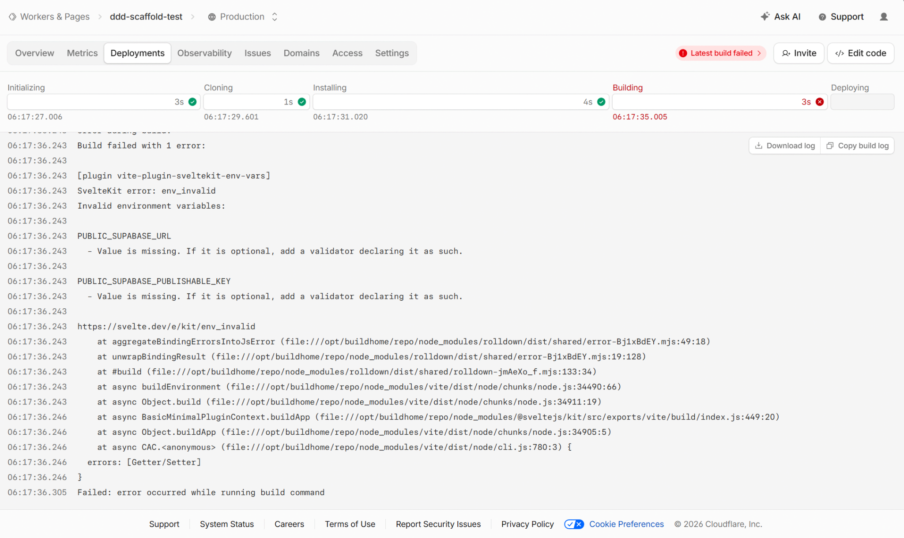
Environment Variables in Cloudflare
We only defined our environment variables in our development build, what about in our production build?

Slide 31
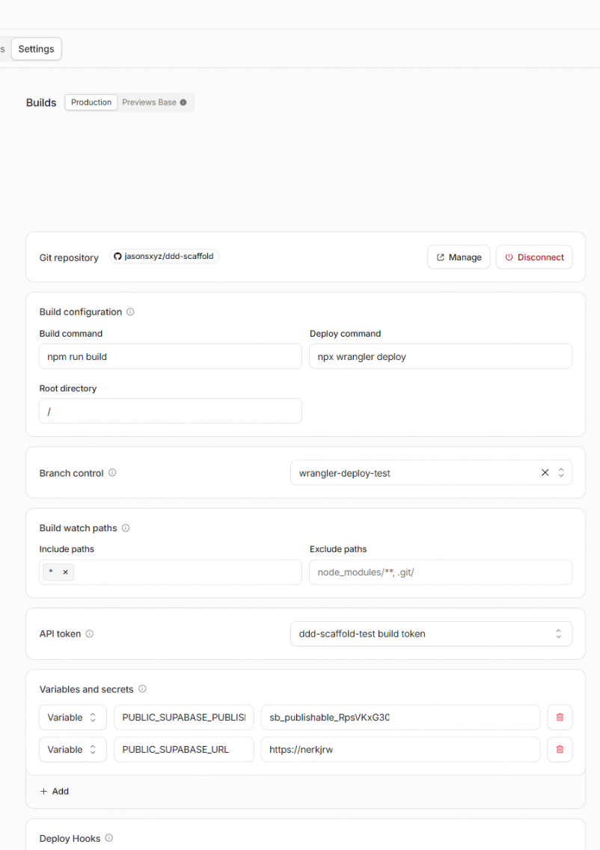
Environment Variables in Cloudflare
Add your public key and url for Supabase into the Build’s variables and secrets.

Slide 32
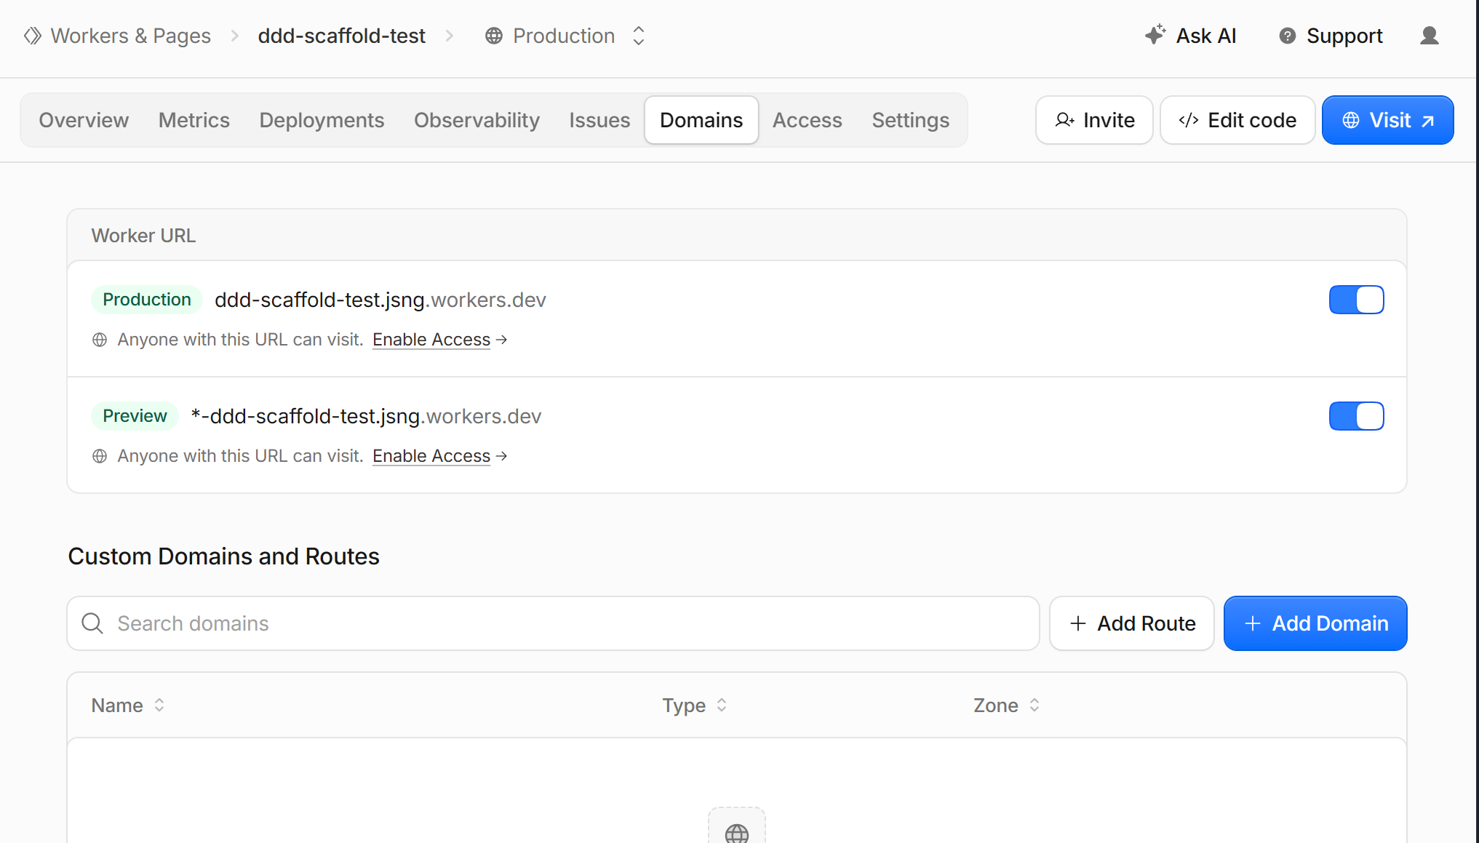
Domains
Cloudflare provides you with a free subdomain to share your project.
You can also link your domain (if you’ve connected it to Cloudflare) to the worker.

Slide 33
Thanks
thanks

Slide 34
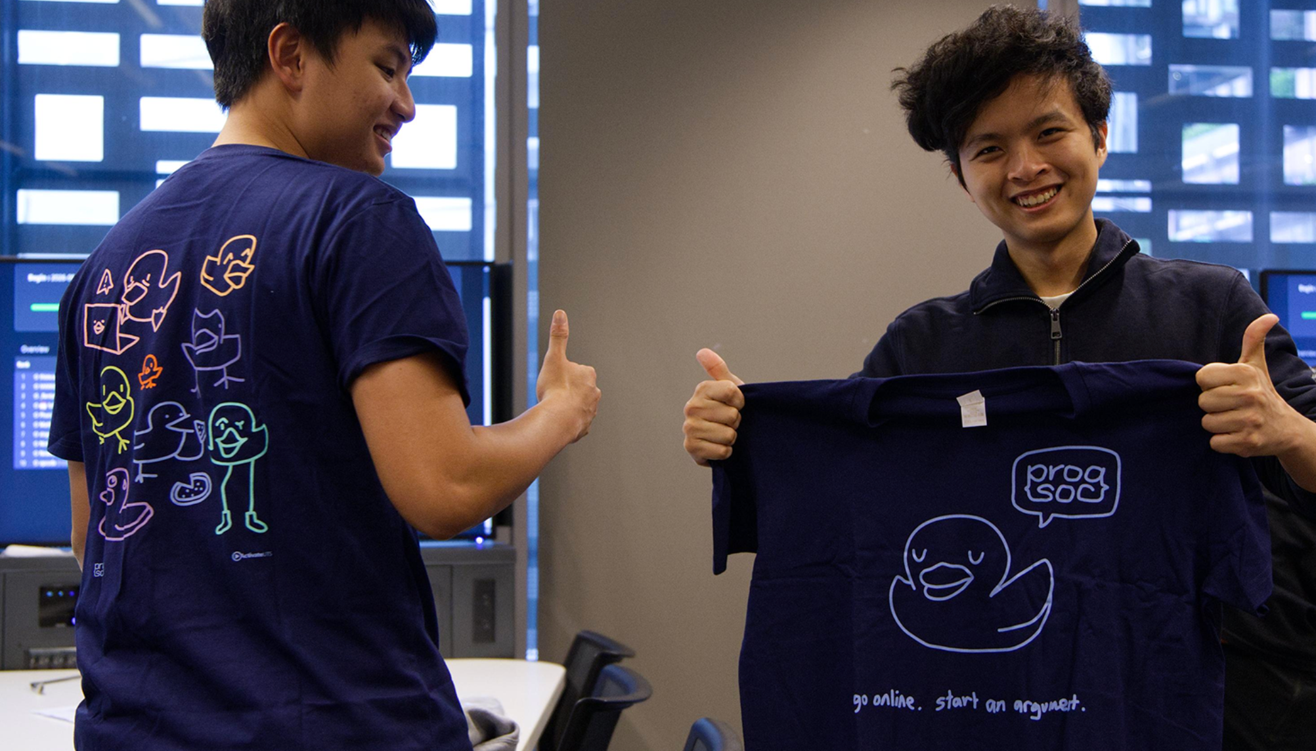

Btw…
Next Week
Quantum@UTS x ProgSoc Hackathon (Wednesday)
Intro to CI/CD (Friday)
WE GOT MERCH
Duckism (shop.progsoc.org)

